Slide 1
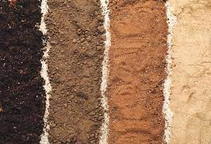
Soil Analysis from Navajo Reservation in Search of Novel Antibiotics
This is a scientific experimental study to be conducted
By
Kaitlan james (BS Biology)
For the MS Biology Thesis Research (in progress)
Under the Supervision of Prof. Dr. Shazia Tabassum Hakim PhD Microbiology
School of STEM, Biomedical Sciences Department, Diné College, Tuba City campus
(Supported by: NSF-TCUP-ICE-TI-2202023)
(NNR-23.483)

Slide 2
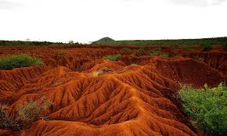
Research Questions
To check how presence of heavy metals, or rare metal in soil can influence the presence of Bacteria in soil?
What chemicals these bacteria produce to survive in presence of other microorganisms?
Can we use this quality of bacteria to cure human infections?
How bacteria differ in dry or vegetative soil?
how type of weather, high altitude, and temperature affect the soil, and soil bacteria?
Important: we are not doing any chemical analysis of soil only isolation of bacteria

Slide 3
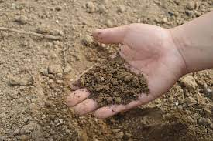
Introduction
Antibiotics are medicines to treat bacterial infections.
90% of the antibiotics we use are obtained from other fungi, bacteria, and molds.
Different texture and composition of soil help grow bacteria differently.
Additionally Navajo reservation has heavy metals and chemical contaminants in the soil that can give the tough time for bacteria to survive and that's why we think that these bacteria might have something special that help them survive in these soil!

Slide 4
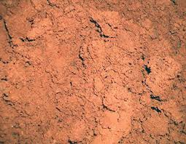
Why I am doing this research?
I have medicine Men/ Women in my family
I know our Navajo elders are known for traditional knowledge on how to collect herbs and shrubs from the mother earth (soil), and use them to heal or cure diseases. They collect soil from different area for different ceremonial purposes.
May be that knowledge of selecting the right type of soil can help me reach the right type of bacteria from that soil.
Antibiotic resistance among bacteria is a real challenge.
May be I can find new chemicals produced by bacteria that can be used as new antibiotics.

Slide 5
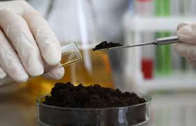
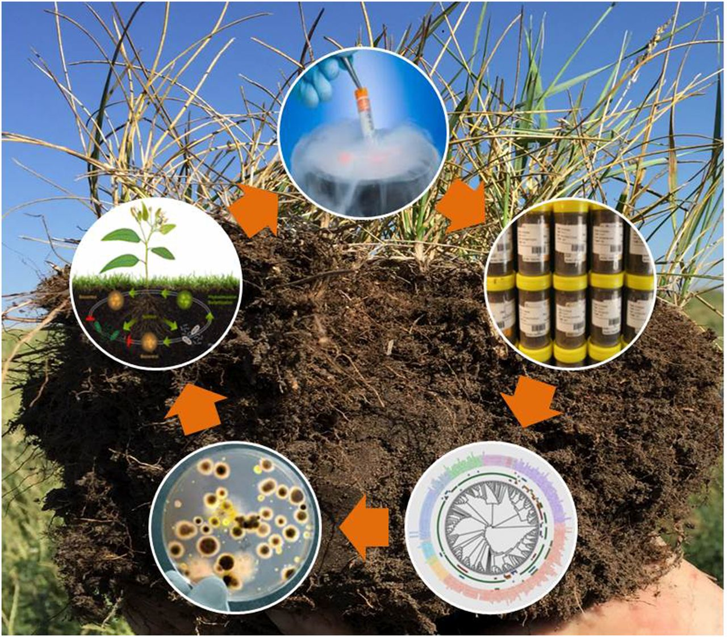
Sample collection
I am currently collecting soil samples from Tuba city and surrounding
But I want to collect samples from other places too, like grand canyon, monument valley, Tsaile, lukachukai.
At this stage We do not want to collect samples from anywhere close to mines to avoid radiation issues
Our preference is housing areas, washes and parks

Slide 6
Method
Mix soil in distill water to make suspension ---> Make serial dilutions → then grow bacteria from these dilutions.
Select few distinctive bacteria to check how much they are effective against growth of other bacteria using patch plate method
Look for clear zone around bacterial patches on lawns of test bacteria
Measure the diameter of clear zone around patch
Extract the chemical from clear zone and purify
Characterize the bacteria by gene sequencing
Serial dilution
MPN
Patch plate
Gel electrophoresis
Pcr
Gene sequencing

Slide 7
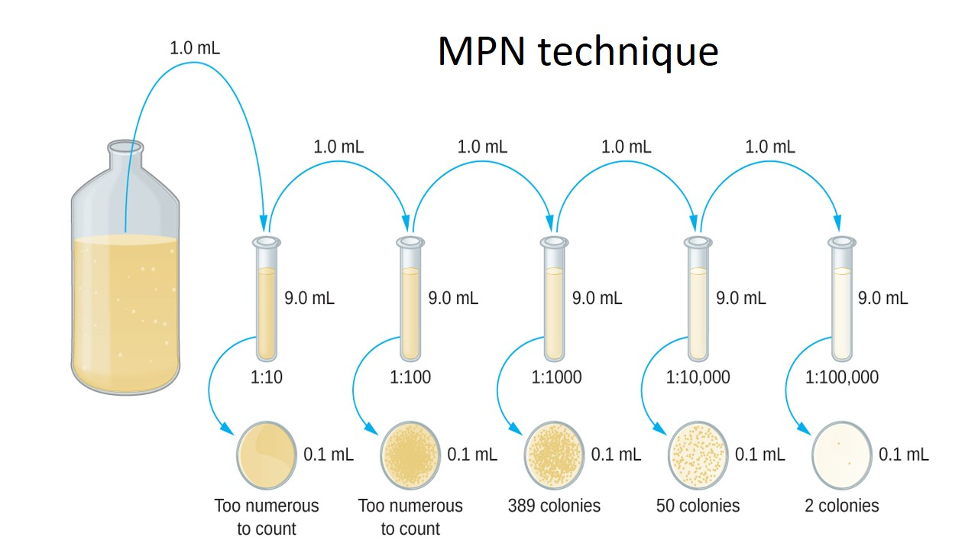

Slide 8
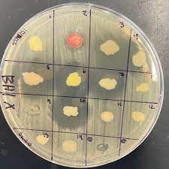
Patch Plate
Bacteria from soil mixture

Slide 9
Possible outcome
Antibiotic resistance among bacteria is a global challenge.
Less effective will be the antibiotics more difficult will be to treat bacterial infections
We should look for all possible ways to combat this challenge
My work will be a contribution to this global effort to find new antibiotics
Antibiotics can equally benefit Navajo and non Navajo patients by helping cure infections

Slide 10
Thank you

